Slide 1
May 2020 MCUL Priority Report
DAVE ADAMS
President/CEO, MCUL/CU Solutions Group

Slide 2
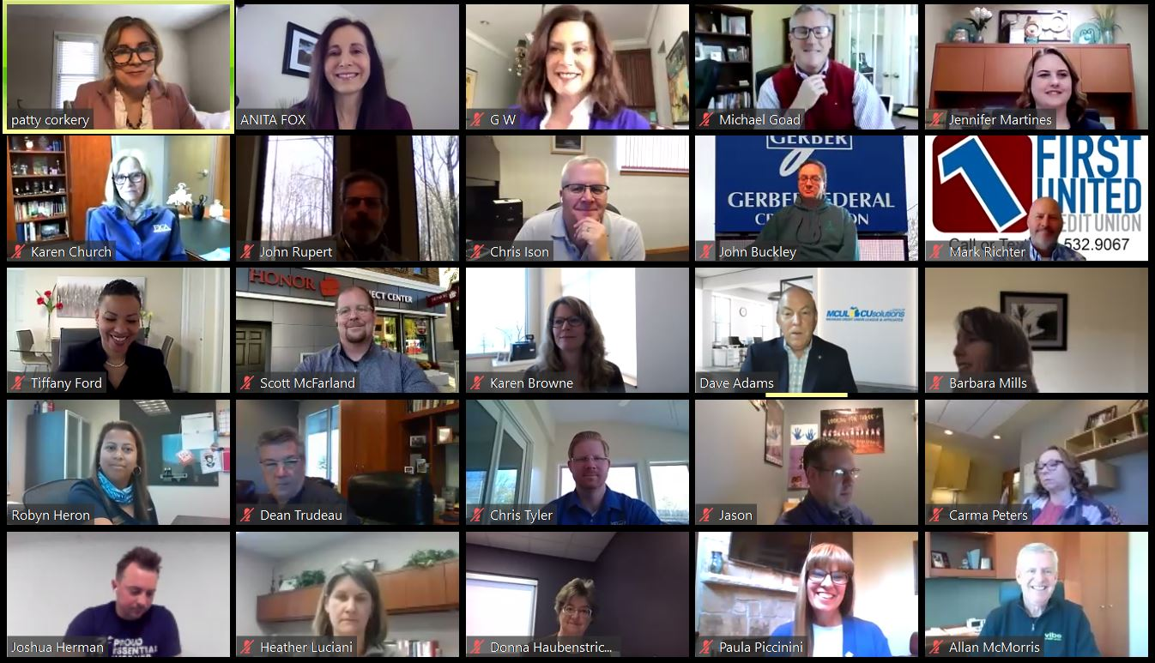
May 2020 Priority Report
Met with Governor Whitmer & DIFS Director Anita Fox
Over 400 credit union professionals joined the call
Discussed impact of COVID-19 health and financial crisis
Communicated our focus of providing for hardest hit members

Slide 3
May 2020 Priority Report
COVID-Response
Nearly 10,000 Paycheck Protection Program loans
10% to new credit union members
Supported the MiMortgage Relief Partnership
140 credit unions and support organizations
Assisted 6,000 homeowners owing $400 million in loans
Look for quarterly reports with more credit union data

Slide 4
Federal Advocacy Agenda
Emergency Stimulus Expansion
Phase 3.5
Provided additional $310 billion for PPP
$30B allocated to financial institutions under $10B in assets
$30B allocated to those between $10-50B in assets
$10B in funding for the Economic Injury Disaster Loan (EIDL) Program,
Permitting farmers and ranchers to receive EIDL assistance.

Slide 5
Federal Advocacy Agenda
Emergency Stimulus Phase 4 (HEROES Act)
Passed by U.S. House
Includes:
Billions in funding for local and state governments
Unemployment insurance
COBRA financial assistance
Wage/salary increase for frontline workers during pandemic
HEROES Act may approach $3T in total funding
Unclear how quickly Senate may act

Slide 6
Federal Advocacy Agenda
Emergency Stimulus Phase 4 (HEROES Act)
MCUL Concerns
Mortgage forbearance
Prohibition on courtesy pay debt collection efforts
Looking Ahead
MCUL advocating for continued relief for state, local and tribal governments
$75B in funding for the proposed Homeowners Assistance Fund

Slide 7
State Advocacy Agenda
Michigan Safe Start Plan
Six phase plan to re-engage Michigan’s economy
Currently in Phase 3 “Flattening Phase” stating:
Still safer at home than in gatherings
Need to continue face coverings in public
Certain sectors of the economy can begin to re-engage safely
Construction
Manufacturing
Real estate
Outdoor work

Slide 8
State Advocacy Agenda
Michigan Safe Start Plan
Parts of Michigan moving to Phase 4
Upper Peninsula
Parts of the northern Lower Peninsula
Retail businesses can open at 50% capacity
Offices where remote work is not possible

Slide 9
State Advocacy Agenda
Legislature Resuming A Regular Session Schedule
Issues focus
Small changes to data breach
Elder abuse
Powers of Attorney (POAs)
Electronic notarization
Appropriations focus
Securing funding for electronic notary implementation and upgrades
Funding for Michigan Saves program

Slide 10
Regulatory Compliance
Working Closely With DIFS and NCUA
Department of Insurance and Financial Services
Discussed 2019 examination survey results
Receptive to our concerns
Including remote examinations and credit union responses to COVID-19 pandemic
Will take a risk-based approach to each credit union
Potential of another survey and meeting after pandemic

Slide 11
Regulatory Compliance
Working Closely With DIFS and NCUA
National Credit Union Administration
Continue to issue interim final rules
Increasing exemption for real estate appraisals from $250,000 to $400,00
Industry guidance on working with members through the pandemic and after
Visit MCUL’s COVID-19 Information page for more information

Slide 12
Regulatory Compliance

Slide 13
Consumer Awareness

Slide 14
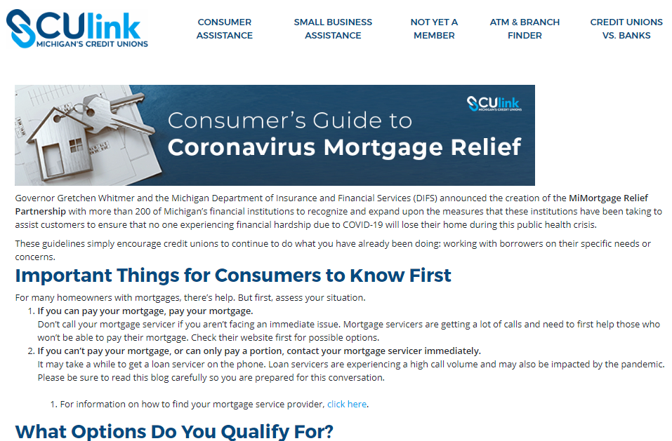
Consumer Awareness

Slide 15
Consumer Awareness

Slide 16
Consumer Awareness

Slide 17
Michigan Credit Union Foundation
Community Crisis Support Grants
Boost potential and on-going credit union initiatives
Michigan Schools & Government Credit Union was able to provide safety equipment to frontline workers
Adapting MCUF Financial Education Programs
Online High School Personal Finance Challenge
Financial quiz bowl streamed live on Facebook
To Leverage MCUF programs and grants visit mcuf.mcul.org

Slide 18
Education
Visit mcul.org

Slide 19
Education
Annual Convention and Exposition

Slide 20
CU Solutions Group
Free Credit Union-Focused Videos
Content covers
Availability of emergency loans
Loan restructuring
Deferred payments
Safe and secure savings reassurance
Free to use by credit unions nationwide
Customizable for a nominal fee of $249
Vidfuel.com

Slide 21
CU Solutions Group
Turnkey Marketing Campaigns
Help increase share of wallet
Easy to customize and deploy
Immediately available
Vidfuel.com

Slide 22
CU Solutions Group
For Current MemberXP Clients
COVID-19 feedback survey within MemberView analytics platform
Can be leveraged immediately in COVID-19 email and website communications
Collect and capture insights

Slide 23
CU Solutions Group
Updating TurboTax marketing assets and communications to account for extended tax deadline
Developed extended marketing plans focused to help:
Increase member engagement
Inform members how the CARES Act impacts filing
Added new discounted offerings
Sam’s Club memberships
Rental Kharma
Home electronics insurance from Asurion

Slide 24
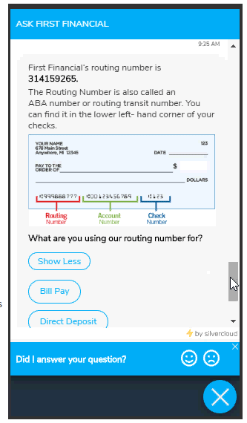
CU Solutions Group
Technology
Solutions for digital and remote services
Shortened timelines for implementation
Enabled features for free
CMS clients have access to all modules in our library at no extra cost
Bold Chat customers can add additional seats at no charge
SilverCloud provides credit unions access to automated remote technologies such as:
Automated member support
Turnkey chat bots
Enhanced employee support

Slide 25
CU Solutions Group
Virtual Team Collaboration
Quick implementation
Free trial period
Collaborate on daily tasks tied to goals and strategic objectives
Generate reports quickly

Slide 26
CU Solutions Group
Crisis-Related Educational Content
Available to credit unions at no cost
Over a dozen courses, including:
Establishing Effective Virtual Teams
Becoming a Successful Collaborator
Managing During Crisis
Assessing and Responding to Risk
Governance and Financial Impact
Lending in Hard Times
Top Questions Credit Unions are Asking

Slide 27
May 2020 MCUL Priority Report
DAVE ADAMS
President/CEO, MCUL/CU Solutions Group

